Slide 1
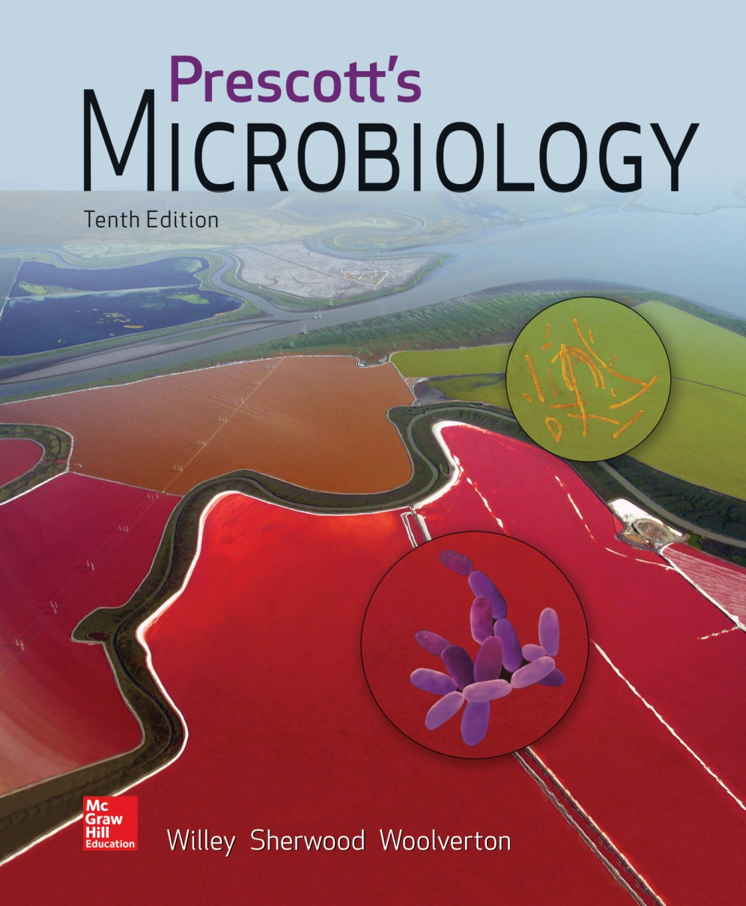
Chapter 8 – Control of Microorganisms in the Environment

Slide 2
8.1 Microbial Growth and Replication Pathways: Targets for Control
Compare and contrast actions of disinfection, antisepsis, chemotherapy, and sterilization
Distinguish between cidal (killing) and static (inhibitory) agents

Slide 3
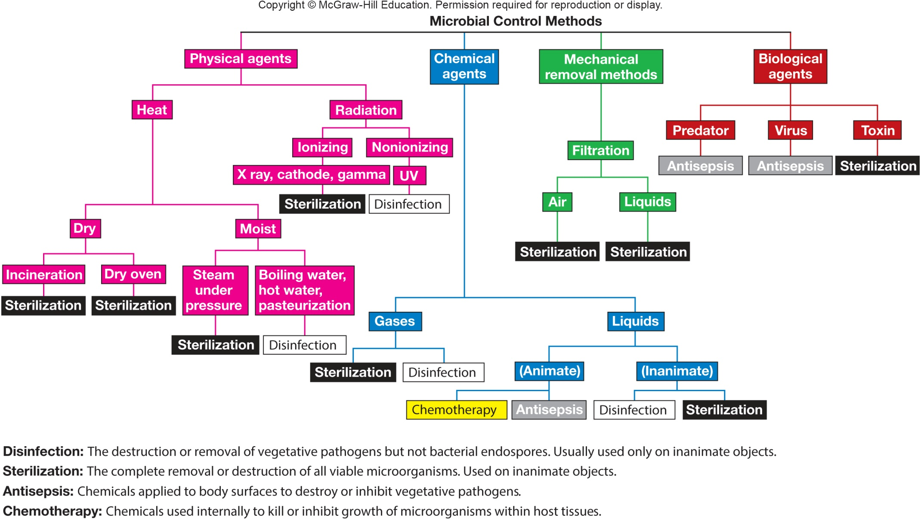
Common Microbial Control Methods

Slide 4
Definition of Frequently Used Terms
Sterilization
destruction or removal of all viable organisms
Disinfection
killing, inhibition, or removal of disease causing (pathogenic) organisms
disinfectants
agents, usually chemical, used for disinfection
usually used on inanimate objects
Sanitization
reduction of microbial population to levels deemed safe (based on public health standards)
Antisepsis
prevention of infection of living tissue by microorganisms
antiseptics
chemical agents that kill or inhibit growth of microorganisms when applied to tissue

Slide 5
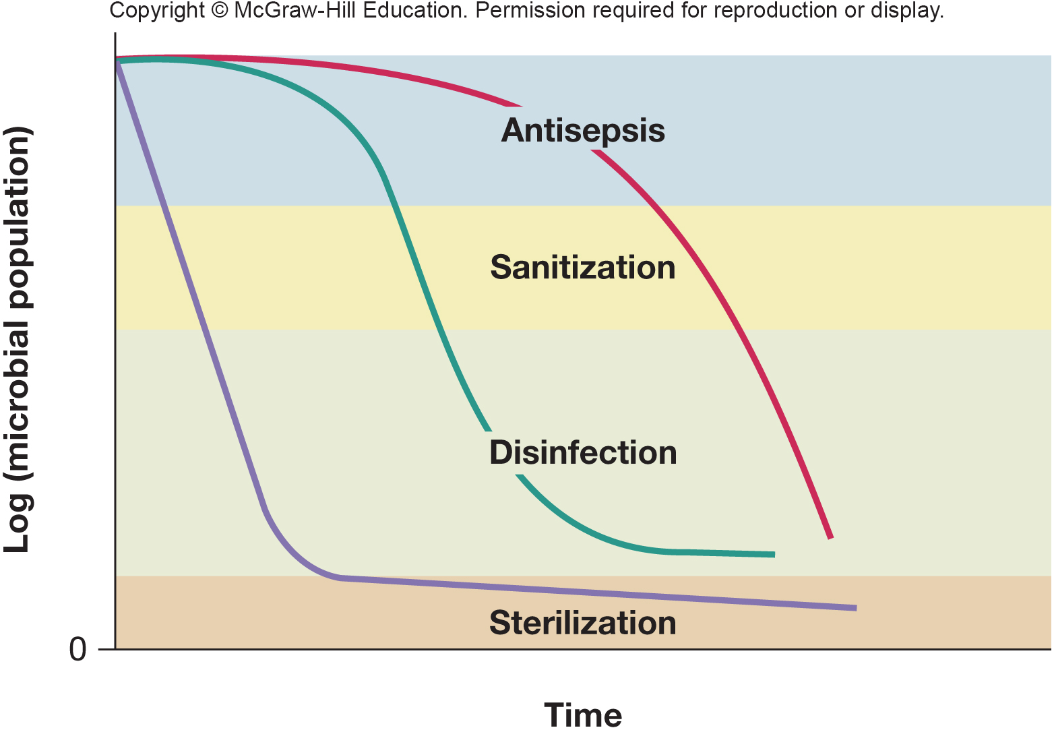
Visual Differentiation of Control Definitions

Slide 6
Antimicrobial Agents
Chemotherapy
use of chemicals to kill or inhibit growth of microorganisms within host tissue
Agents that kill microorganisms or inhibit their growth
cidal agents kill (-cide suffice indicating agent that kills)
germicide kills pathogens and many nonpathogens but not necessarily endospores
include bactericides, fungicides, algicides, and viricides
static agents inhibit growth (-static suffix indicates growth inhibiting agent)
include bacteriostatic and fungistatic

Slide 7
8.2 The Pattern of Microbial Death Mirrors the Pattern of Microbial Growth
Calculate the decimal reduction time (D value)
Correlate antisepsis, disinfection, and sterilization with agent effectiveness

Slide 8
The Pattern of Microbial Death
Microorganisms are not killed instantly
Population death usually occurs exponentially
Measure of agent’s killing efficiency
decimal reduction time – time to kill 90%
must be sure persister cells (viable but nonculturable condition) are dead
once they recover they may regain the ability to reproduce and cause infection

Slide 9
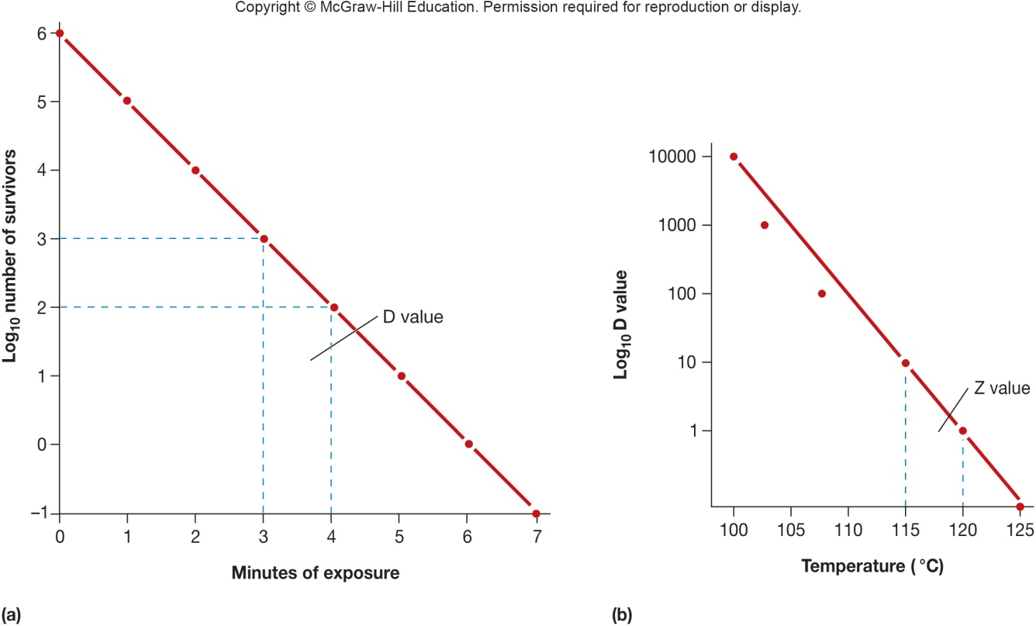
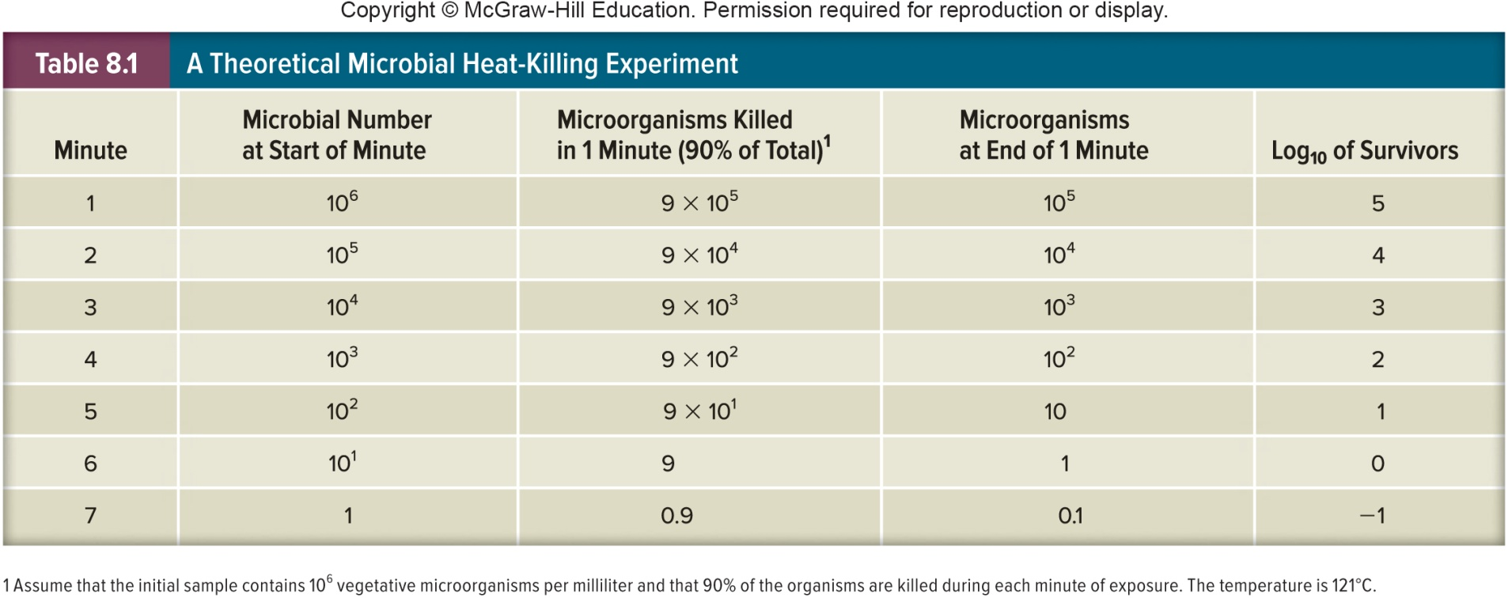
D and z Values

Slide 10
8.3 Mechanical Removal Methods Rely on Barriers
Explain the mechanism by which filtration removes microorganisms
Propose filtration methods to selectively remove one type of microbe from a mixed population

Slide 11
Filtration
Reduces microbial population or sterilizes solutions of heat-sensitive materials by removing microorganisms
Also used to reduce microbial populations in air

Slide 12
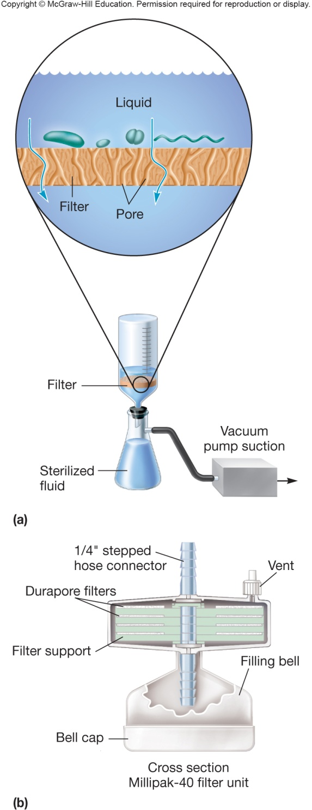
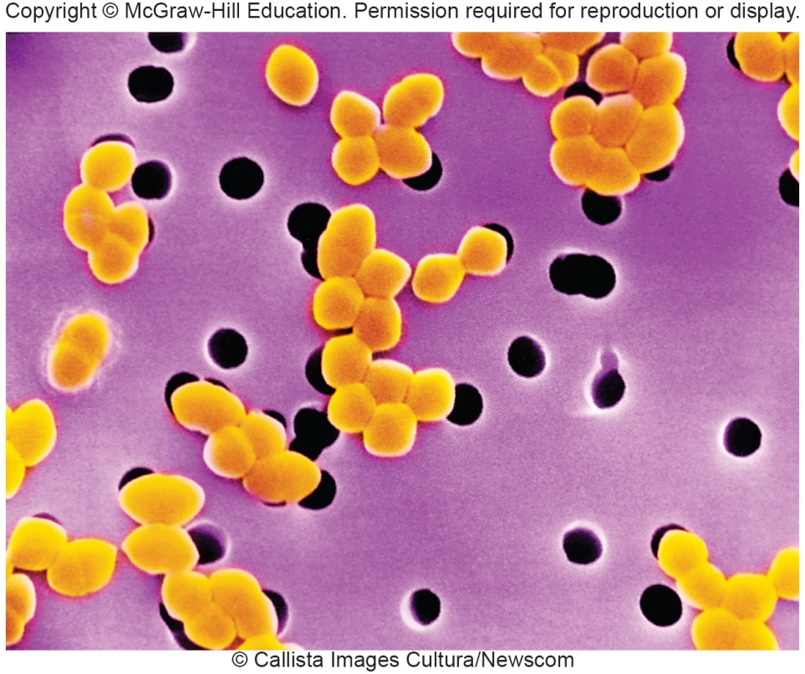
Filtering Liquids Membrane filters -porous membranes with defined pore sizes that remove microorganisms primarily by physical screening

Slide 13
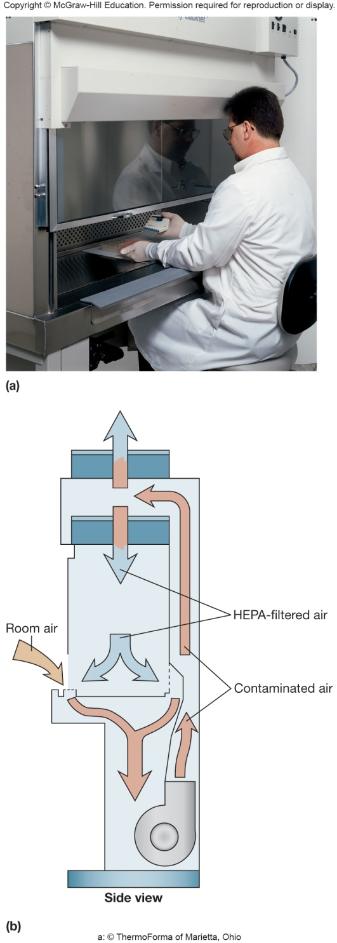
Filtering Air
Surgical masks
Cotton plugs on culture vessels
High-efficiency particulate air (HEPA) filters
used in laminar flow biological safety cabinets

Slide 14
8.4 Physical Control Methods Alter Microorganisms to Make Them Nonviable
Describe the application of heat and radiation to control microorganisms
Explain the mechanisms by which heat and radiation kill microbes
Design novel antimicrobial control applications using heat and radiation to sterilize

Slide 15
Physical Control Methods
Heat
Radiation

Slide 16
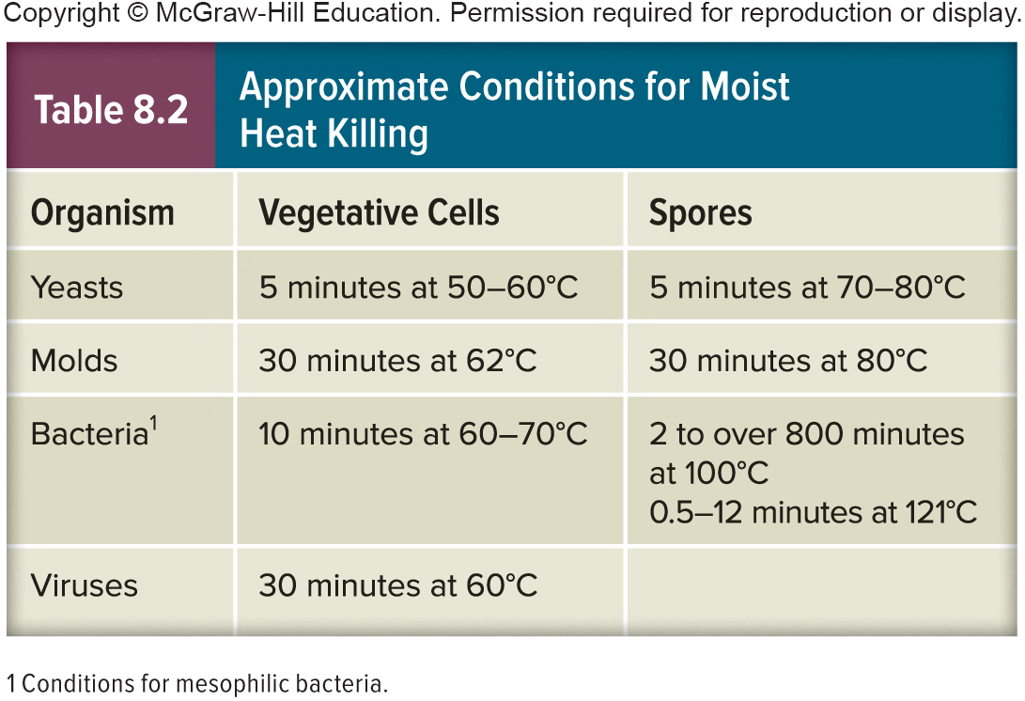
Moist Heat
Destroys viruses, fungi, and bacteria
Boiling will not destroy spores and does not sterilize
Degrades nucleic acids, denatures proteins, and disrupts membranes

Slide 17
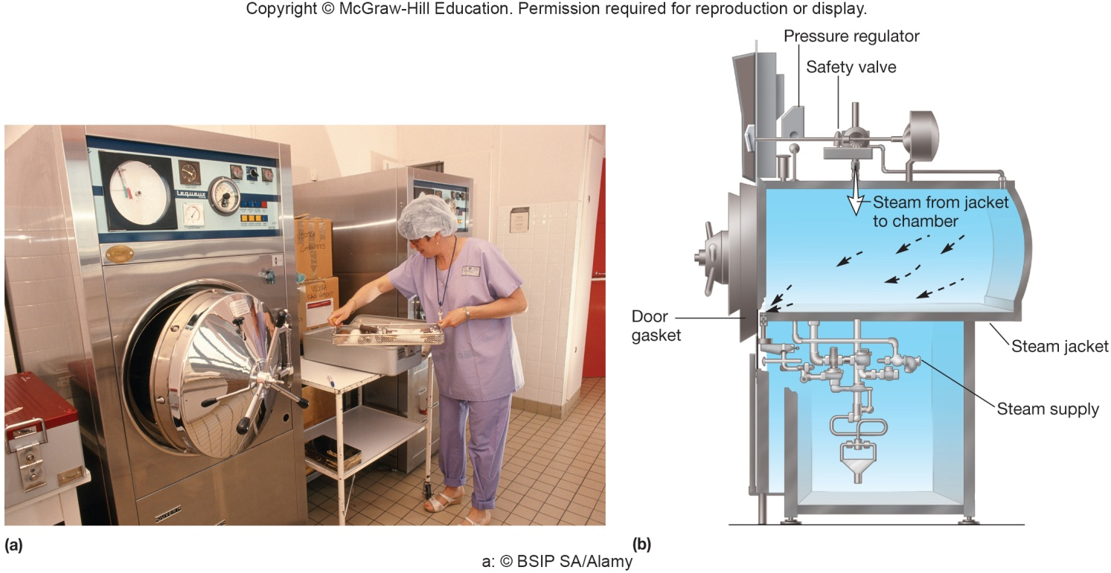
Steam Sterilization
Carried out above 100ºC which requires saturated steam under pressure
Uses an autoclave
Effective against all types of microorganisms (including spores!)
Quality control - includes strips with Geobacillus stearothermophilus

Slide 18
Pasteurization
Controlled heating at temperatures well below boiling
Used for milk, beer, and other beverages
Process does not sterilize but does kill pathogens present and slow spoilage by reducing the total load of organisms present

Slide 19
Dry Heat Sterilization
Less effective than moist heat sterilization, requiring higher temperatures and longer exposure times
items subjected to 160–170ºC for 2 to 3 hours
Oxidizes cell constituents and denatures proteins

Slide 20
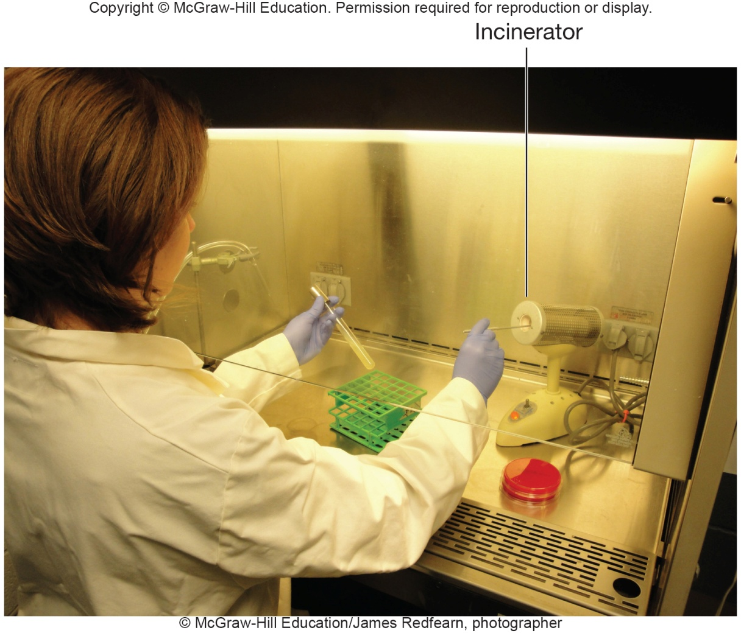
Dry Heat Incineration
Bench top incinerators are used to sterilize inoculating loops used in microbiology laboratories
Note that dry heat sterilization and dry heat incineration are different control methods!

Slide 21
Ultraviolet (UV) Radiation
Wavelength of 260 is most bactericidal (DNA absorbs)
Causes thymine dimers preventing replication and transcription
UV limited to surface sterilization because it does not penetrate glass, dirt films, water, and other substances
Has been used for water treatment

Slide 22
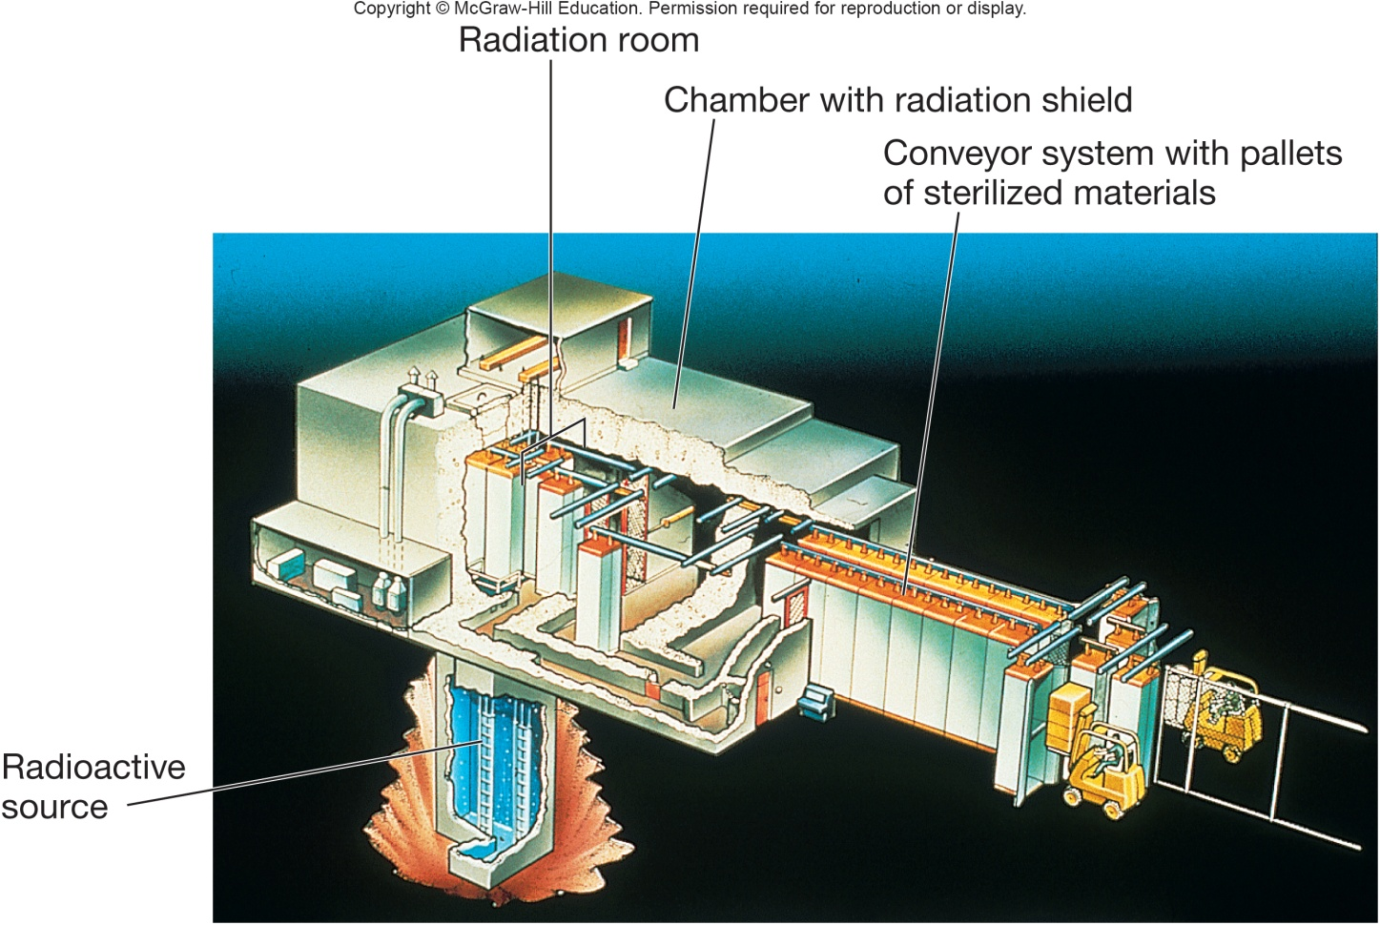
Ionizing Radiation
Gamma radiation penetrates deep into objects
Destroys bacterial endospores; not always effective against viruses
Used for sterilization and pasteurization of antibiotics, hormones, sutures, plastic disposable supplies, and food

Slide 23
8.5 Microorganisms Are Controlled With Chemical Agents
Describe the use of phenolics, alcohols, halogens, heavy metals, quaternary ammonium chlorides, aldehydes, and oxides to control microorganisms
Explain the mechanisms of action for phenolics, alcohols, halogens, heavy metals, quaternary ammonium chlorides, aldehydes, and oxides
Design novel antimicrobial control applications using phenolics, alcohols, halogens, heavy metals, quaternary ammonium chlorides, aldehydes, and oxides

Slide 24
Chemical Control Agents and Their Requirements
Disinfection
must be effective against wide variety of infectious agents at low concentrations
Antisepsis
Overuse of antiseptics such as triclosan has selected for triclosan resistant bacteria and possibly antibiotic resistant
Sterilization
Whichever chemical is used, it must be effective in the presence of organic matter; should be stable in storage

Slide 25
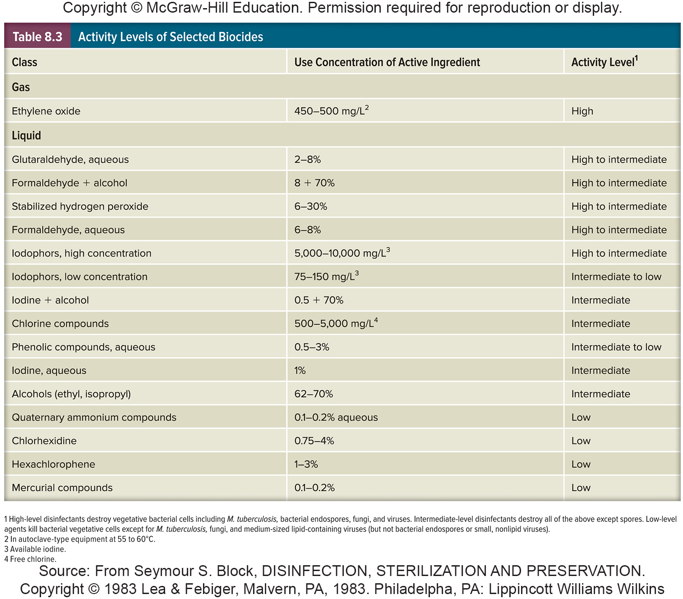
Activity Levels of Different Chemicals

Slide 26
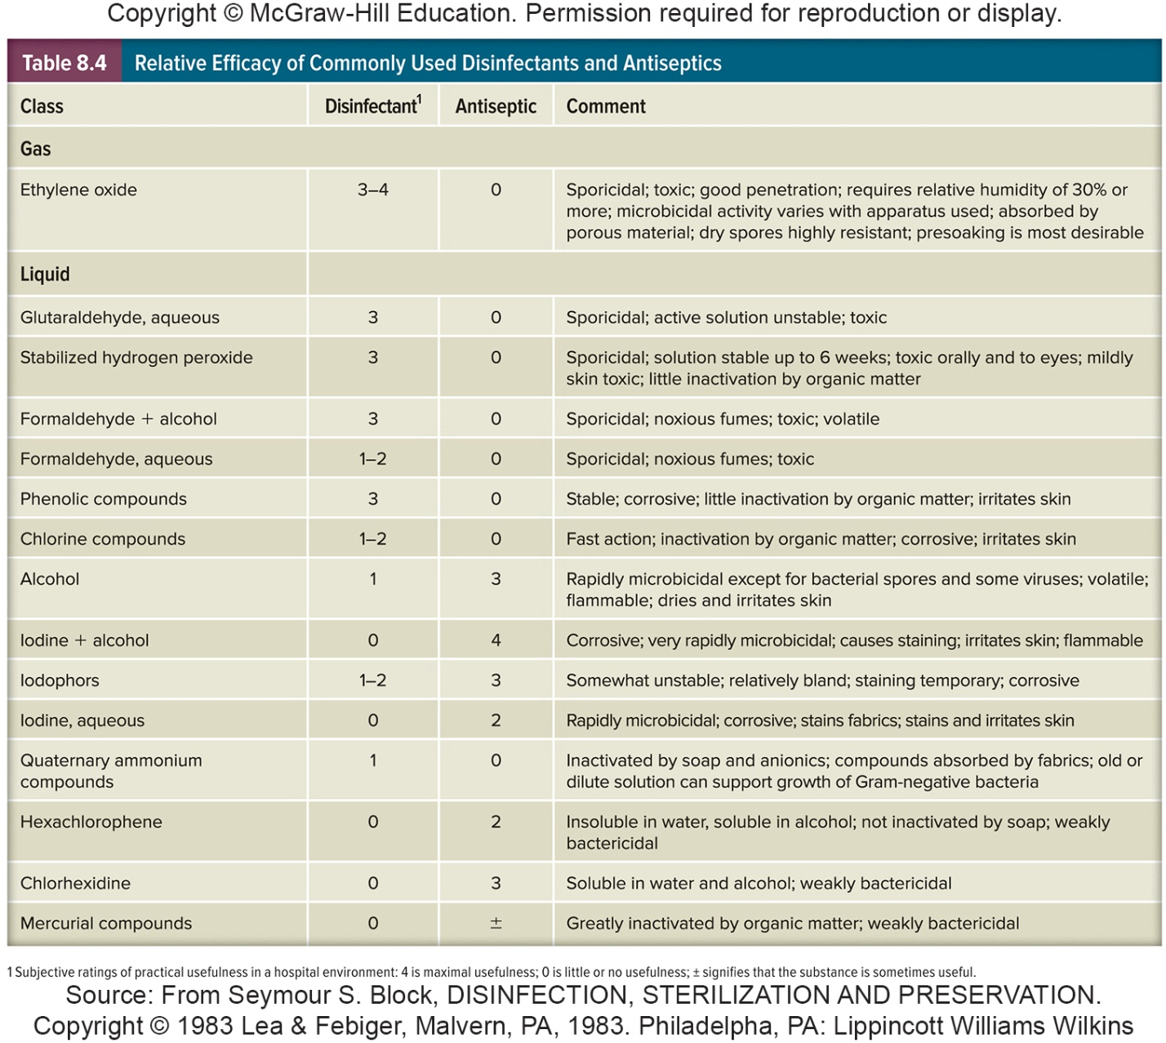
Efficiency of Different Chemical Compounds

Slide 27
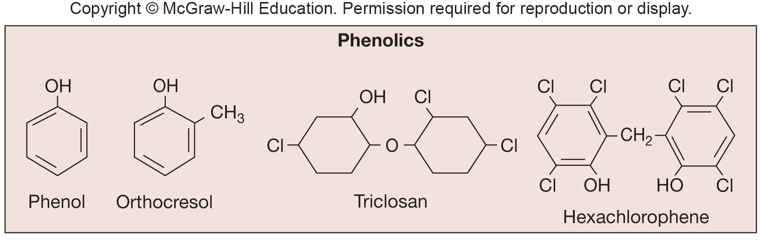
Phenolics
Commonly used as laboratory and hospital disinfectants
Act by denaturing proteins and disrupting cell membranes
Tuberculocidal, effective in presence of organic material, and long lasting
Disagreeable odor and can cause skin irritation

Slide 28

Alcohols
Among the most widely used disinfectants and antiseptics
Two most common are ethanol and isopropanol
Bactericidal, fungicidal, but not sporicidal
Inactivate some viruses
Denature proteins and possibly dissolve membrane lipids

Slide 29
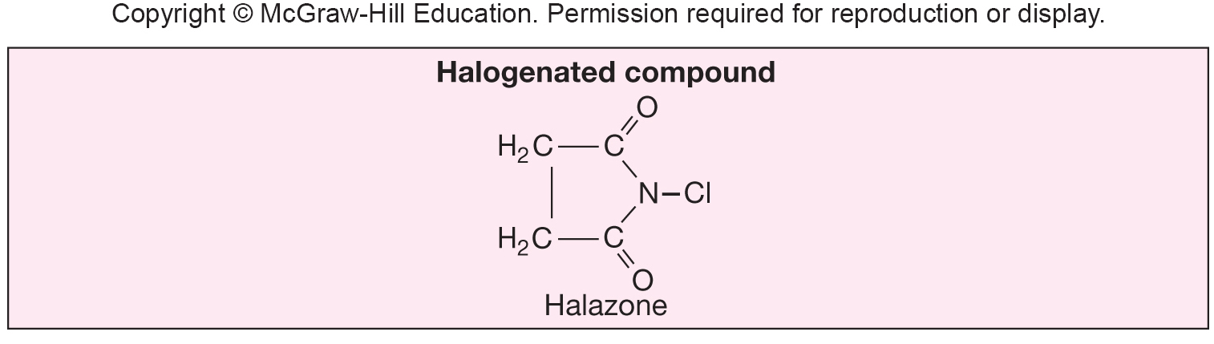
Halogens
Any of five elements: fluorine, chlorine, bromine, iodine, and astatine
Important antimicrobial agents

Slide 30
Halogens - Iodine
Skin antiseptic
Oxidizes cell constituents and iodinates proteins
At high concentrations may kill spores
Skin damage, staining, and allergies can be a problem
Iodophore
iodine complexed with organic carrier
released slowly to minimize skin burns

Slide 31
Halogens - Chlorine
Oxidizes cell constituents
Important in disinfection of water supplies and swimming pools, used in dairy and food industries, effective household disinfectant
Destroys vegetative bacteria and fungi
Chlorine gas is sporicidal
Can react with organic matter to form carcinogenic compounds

Slide 32
Heavy Metals
e.g. ions of mercury, silver, arsenic, zinc, and copper
Effective but usually toxic
Combine with and inactivate proteins; may also precipitate proteins

Slide 33
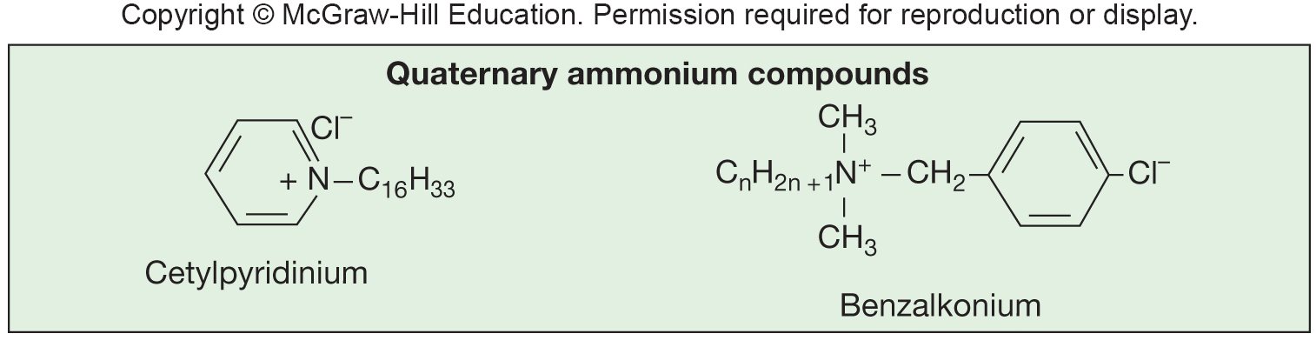
Quaternary Ammonium Compounds
Detergents that have antimicrobial activity and are effective disinfectants
amphipathic organic cleansing agents
Cationic detergents are effective disinfectants
kill most bacteria, but not M. tuberculosis or endospores
safe and easy to use, inactivated by hard water and soap

Slide 34
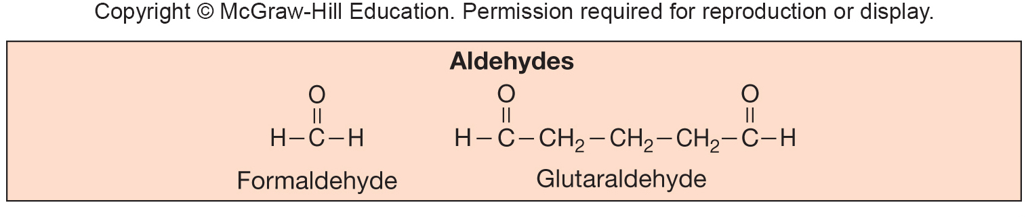
Aldehydes
Commonly used agents are formaldehyde and glutaraldehyde
Highly reactive molecules
Sporicidal and can be used as chemical sterilants
Combine with and inactivate nucleic acids and proteins

Slide 35
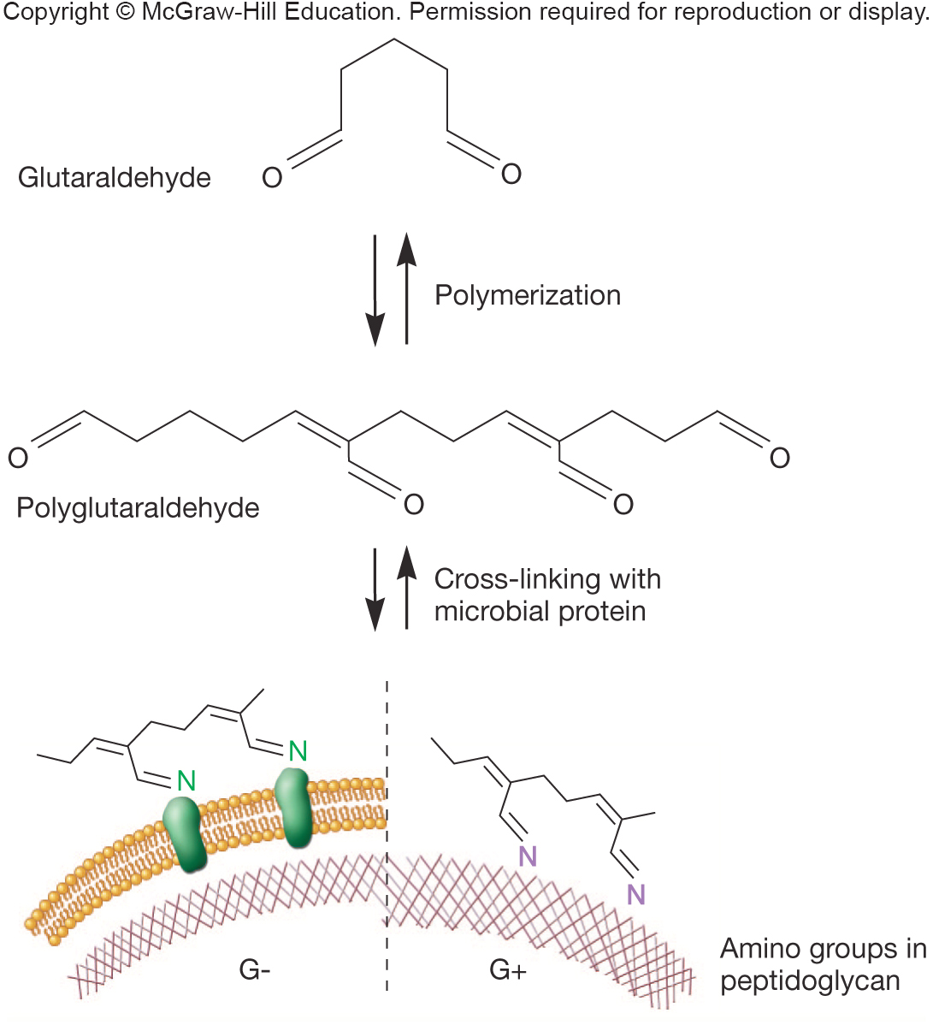
Effects of Glutaraldehyde

Slide 36
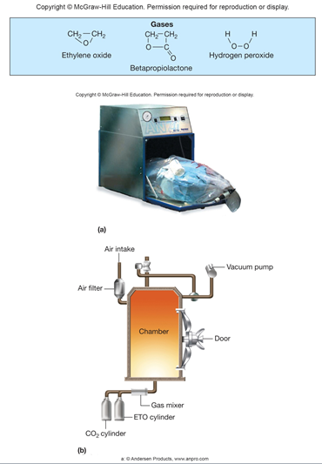
Sterilizing Gases
Used to sterilize heat-sensitive materials
Microbicidal and sporicidal
Ethylene oxide sterilization is carried out in equipment resembling an autoclave
Betapropiolactone and vaporized hydrogen peroxide
Combine with and inactivate DNA and proteins

Slide 37
8.6 Antimicrobial Agents Must Be Evaluated for Effectiveness
Predict the effects of (1) microbial population size and composition, (2) temperature, (3) exposure time, and (4) local environmental conditions on antimicrobial agent effectiveness
Describe the processes used to measure microbial killing rates, dilution testing, and in-use testing of antimicrobial agents

Slide 38
Evaluation of Antimicrobial Agent Effectiveness
Complex process regulated by U.S. federal agencies
Environmental Protection Agency
Food and Drug Administration

Slide 39
Conditions Influencing the Effectiveness of Antimicrobial Agent Activity
Population size
larger populations take longer to kill than smaller populations
Population composition
microorganisms differ markedly in their sensitivity to antimicrobial agents
Concentration or intensity of an antimicrobial agent
usually higher concentrations kill more rapidly
relationship is not linear
Duration of exposure
longer exposure ⇒ more organisms killed
Temperature
higher temperatures usually increase killing
Local environment
pH, viscosity, concentration of organic matter, etc. can profoundly impact effectiveness
organisms in biofilms are less susceptible to many antimicrobial agents

Slide 40
Efficiency Evaluation of Chemical Agents
Phenol Coefficient Test
potency of a disinfectant is compared to that of phenol
useful for screening but may be misleading
Use dilution test
determines rate at which selected bacteria are destroyed by various chemical agents
Normal in-use testing
testing done using conditions that approximate normal use of disinfectant

Slide 41
8.7 Microorganisms Can Be Controlled by Biological Methods
Propose predation, competition, and other methods for biological control of microorganisms
Suggest alternative decontamination and medical therapies using viruses of bacteria, fungi, and protozoa

Slide 42
Biological Control of Microorganisms
Emerging field showing great promise
Natural control mechanisms
predation by Bdellovibrio
viral-mediated lysis using pathogen specific bacteriophage lysins (or bacteriophages themselves, such as in a spray format recently approved by the FDA for use on food products)
toxin-mediated killing using bacteriocins

Slide 43
Take Home Message
Controlling microbial growth can be achieved by many different methods – some physical, some chemical
Understanding what microbes need to grow and thrive is important for then understanding how to kill them off or control their growth
While many of these methods are useful, each has pros and cons – and each may not be suitable in particular circumstances
Always be thinking about what the appropriate and most useful way to control microbe growth in a given environment or situation might be using the information found in this chapter

